Slide 1
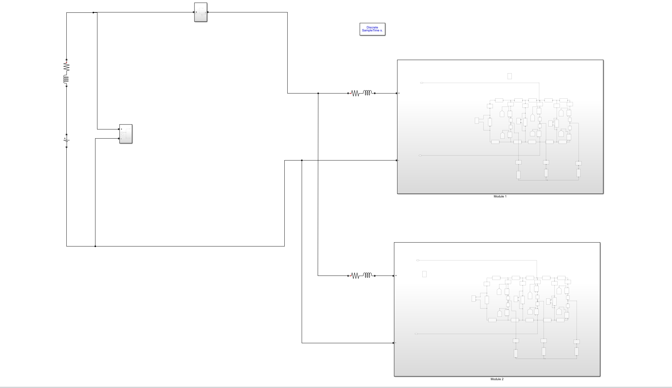
Parasitic Model with multi-modules

Slide 2
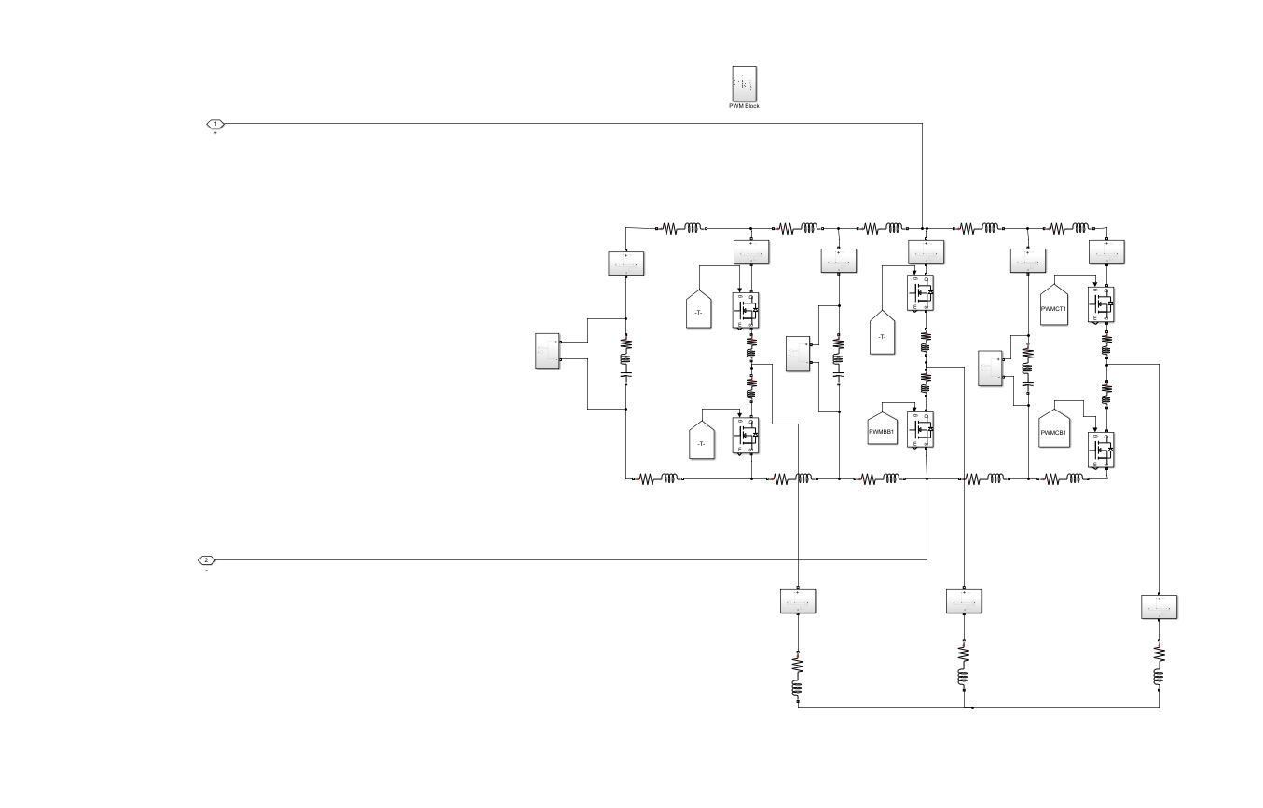

Slide 3
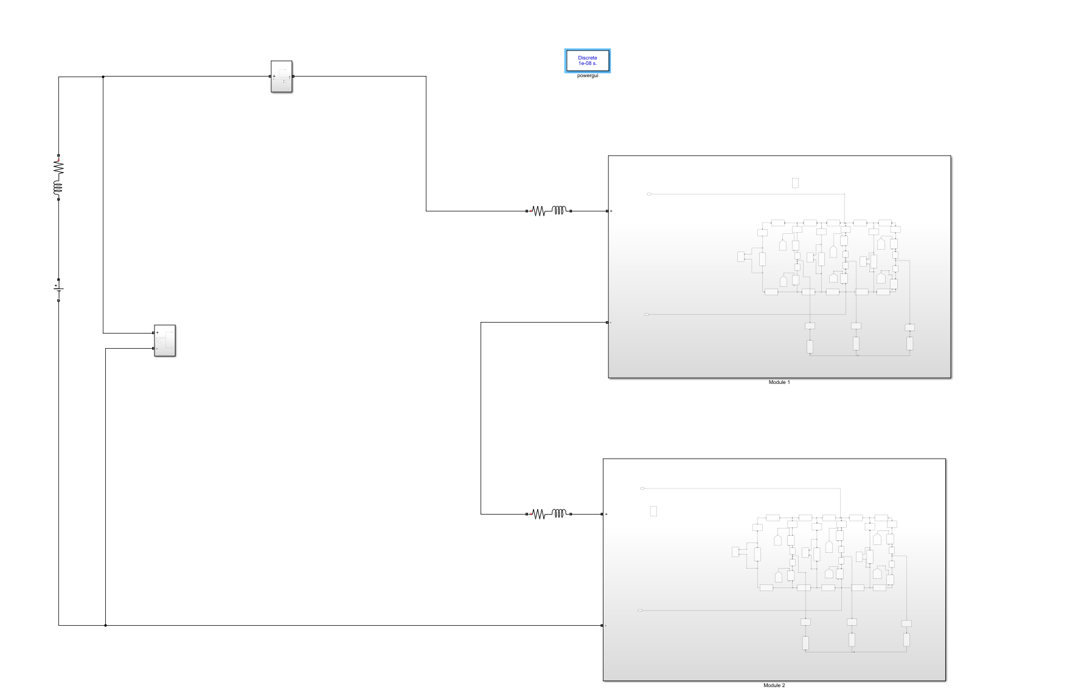

Slide 4
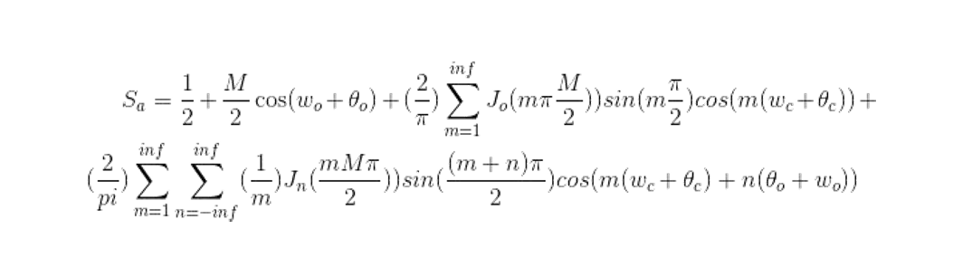
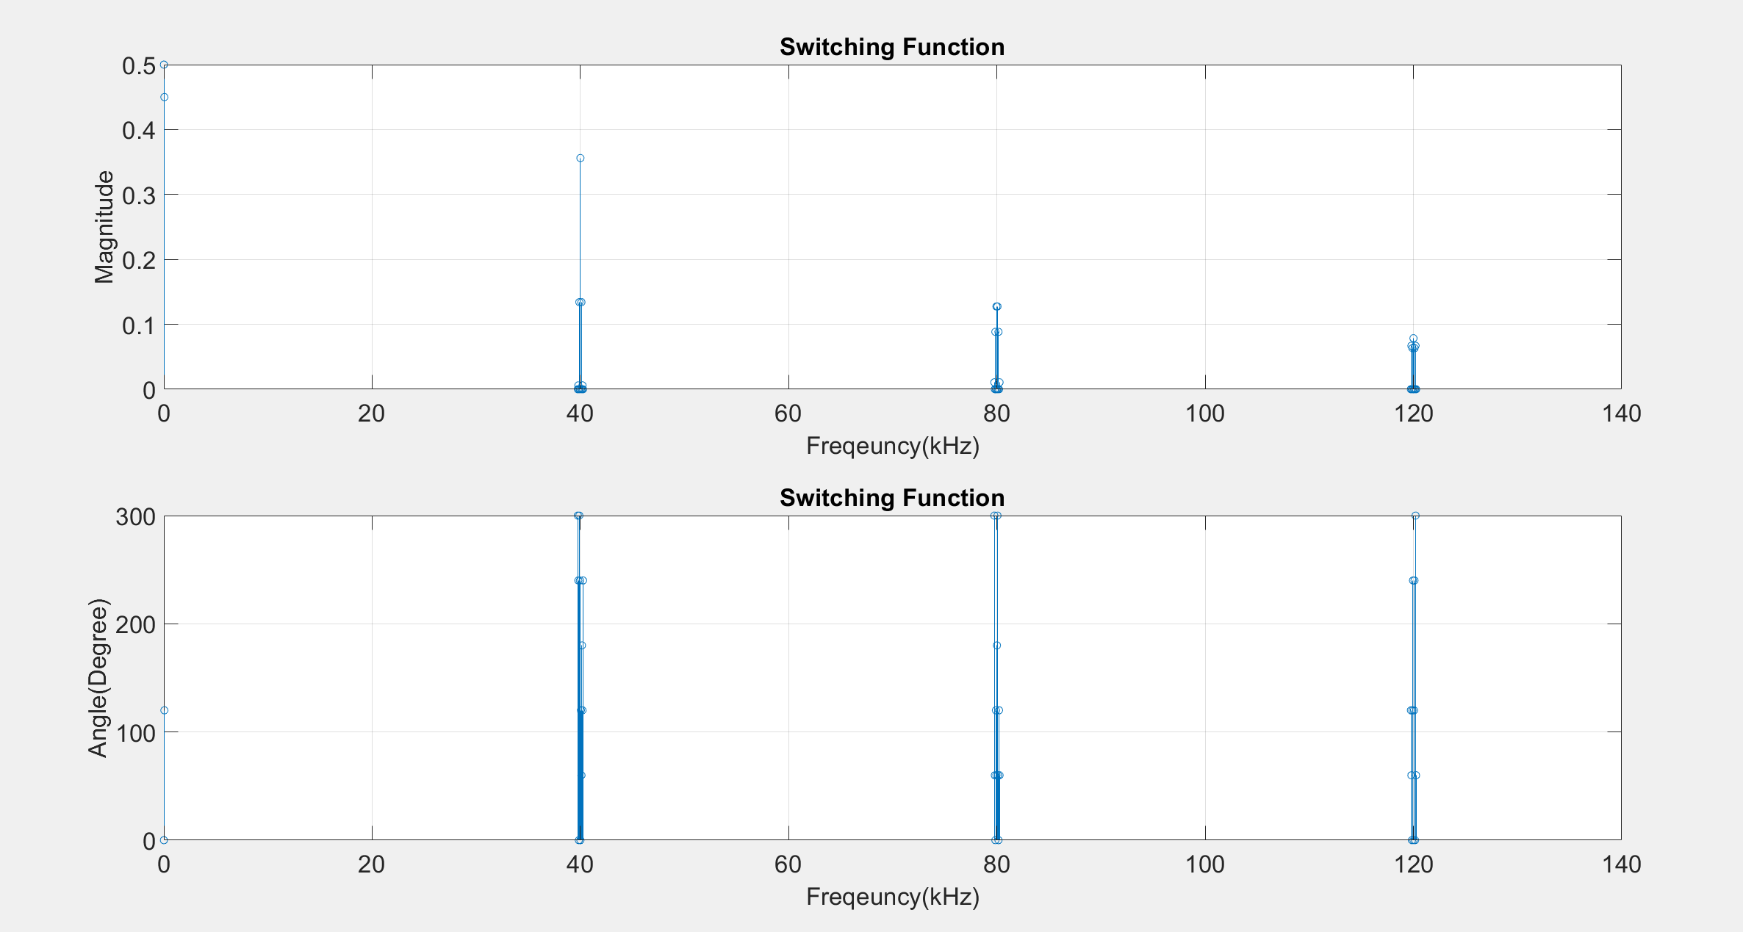
SWITCHING FUNCTION
Parameters:
k=0.9; % modulation index
f_o=50; % output frequcency(fundamental)
f_c=4e4; % carrier frequency (switching)
The_o=2*pi/3; % output phase
The_c=0; % carrier phase
m_max=20; % maximum harmonics of carrier
n_max=20; % The number of sidebands

Slide 5
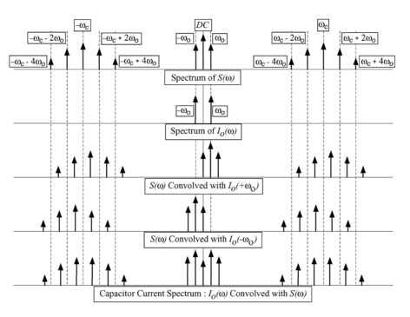
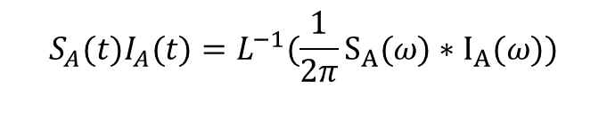
LEG FUNCTION
The switching function is convolved with load current.
$$S_{A}(t)I_{A}(t)=L^{−1}({\frac{1}{2π}S}_{A}(ω)∗I_{A}(ω))$$

Slide 6
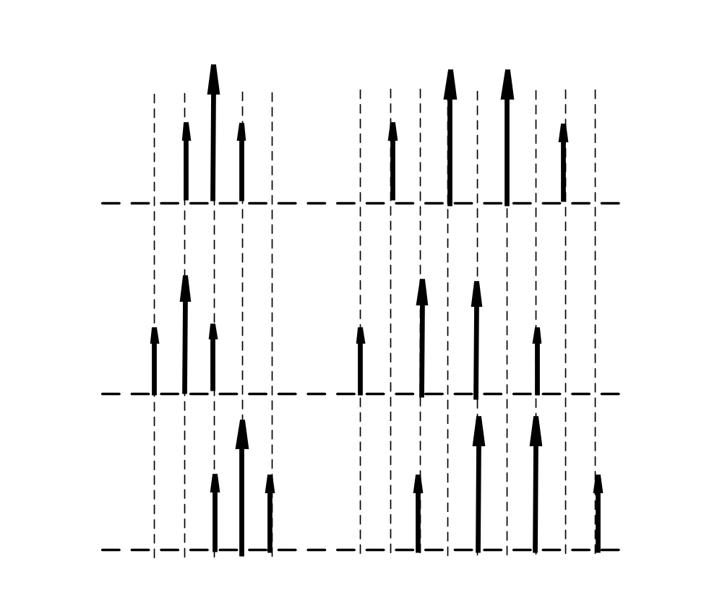
$\cos\left(ωt−θ\right)\cos\left(ω_{o}t−φ\right)=\frac{1}{2}(\cos\left(ωt −ω_{o}t+φ−θ\right)+cos⁡(ωt+ω_{o}t−φ−θ))$
Sliding Left
Sliding Right
Switching Function
Switching Function sliding left
Switching Function sliding right

Slide 7
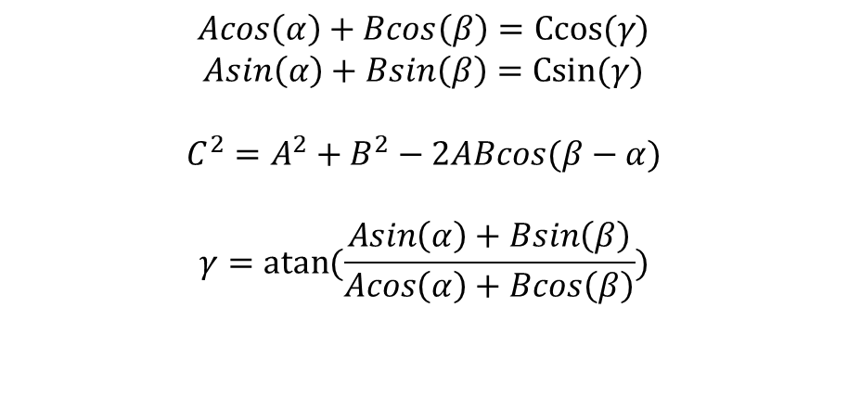
$$Acos\left(α\right)+Bcos\left(β\right)=Ccos(γ)$$
$$Asin\left(α\right)+Bsin\left(β\right)=Csin(γ)$$
$$C^{2}=A^{2}+B^{2}−2ABcos(β−α)$$
$$γ=atan(\frac{Asin\left(α\right)+Bsin\left(β\right)}{Acos\left(α\right)+Bcos\left(β\right)})$$
$$Acos\left(ωt−α\right)+Bcos\left(ωt−β\right)=Ccos(ωt−γ)$$

Slide 8
Parameters:
k=0.9; % modulation index
f_o=50; % output frequcency(fundamental)
f_c=4e4; % carrier frequency (switching)
The_o=2*pi/3; % output phase
The_c=0; % carrier phase
m_max=20; % maximum harmonics of carrier
n_max=20; % The number of sidebands
I_mag=5; % Load current magnitude
I_phase=0; % Load current phase

Slide 9
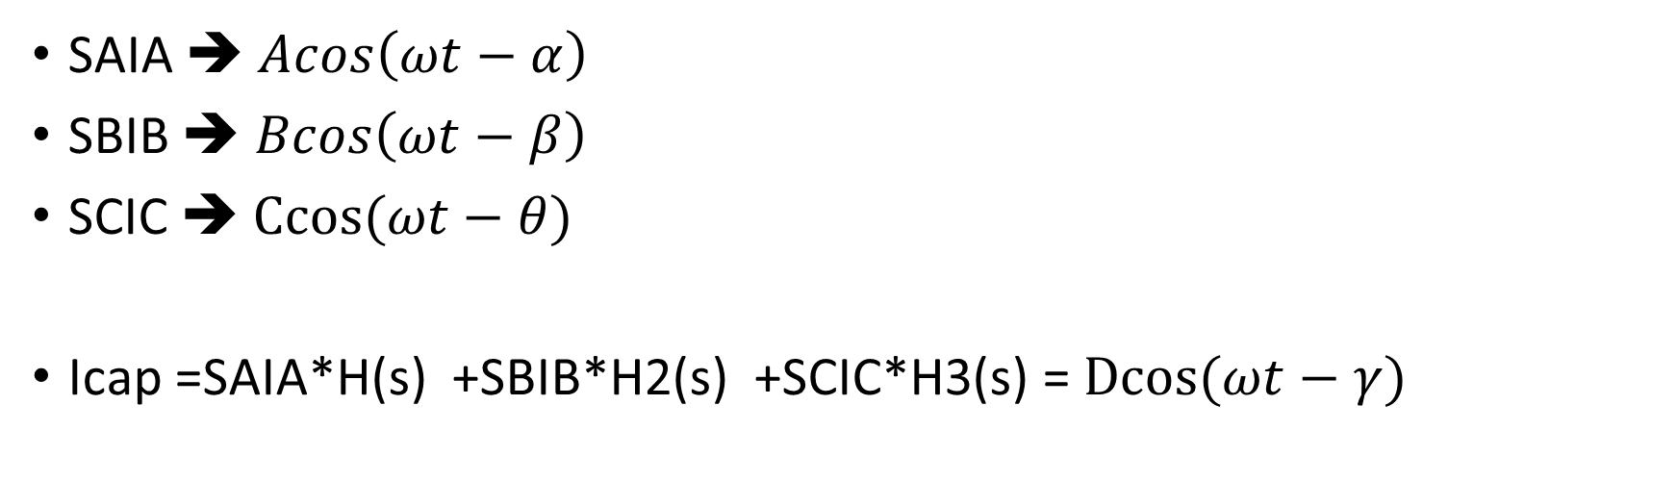
Impedance Model
SAIA ➔ $Acos\left(ωt−α\right)$
SBIB ➔ $Bcos\left(ωt−β\right)$
SCIC ➔ $Ccos(ωt−θ)$
Icap =SAIA*H(s) +SBIB*H2(s) +SCIC*H3(s) = $Dcos(ωt−γ)$

Slide 10
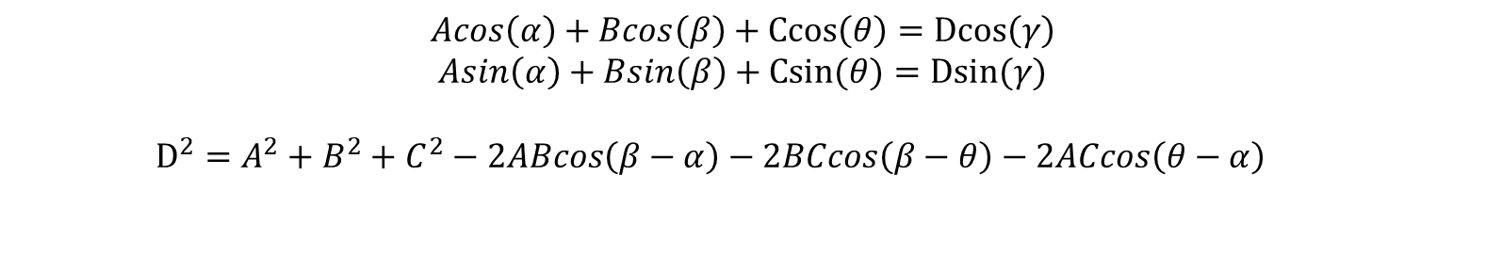
$$Acos\left(α\right)+Bcos\left(β\right)+Ccos\left(θ\right)=Dcos\left(γ\right)$$
$$Asin\left(α\right)+Bsin\left(β\right)+Csin(θ)=Dsin(γ)$$
$D^{2}=A^{2}+B^{2}+C^{2}−2ABcos\left(β−α\right)−2BCcos\left(β−θ\right)−2ACcos\left(θ−α\right)$

